Slide 1
Spring Introduction

Slide 2
Module Overview
In this Module, we will learn the following:
Architecture of Spring Core
Environment Setup
Hello World Example

Slide 3
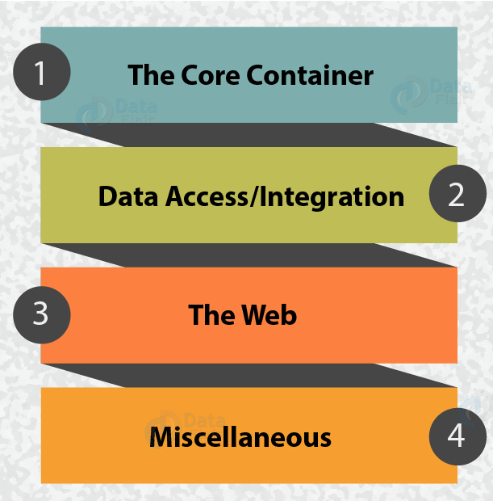
Architecture
Spring Framework Architecture
The core concept for developing Spring Framework was to make it a one-stop solution where you can integrate and use the modules according to the need of your application.
Around 20 modules of the Spring framework are being used according to the nature of the application.

Slide 4
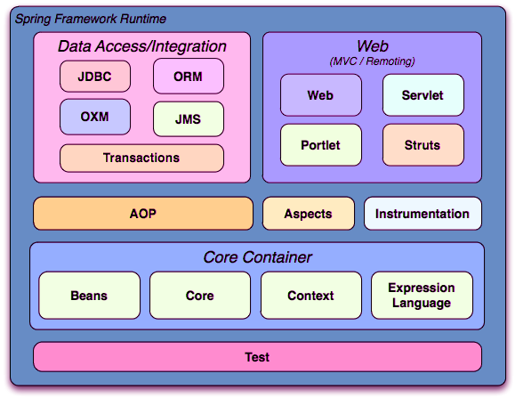
Modules of Spring Architecture
The Spring Framework Architecture contains 4 main modules namely:
Core Container
Data Access/Integration
The Web Container
AOP and Instrumentation
Test

Slide 5
Spring Modules Cont…
Core Container
It comprises of the Core, Beans, Context, and Expression Language modules.
Core and Beans modules:
The modules- core and beans provide the framework fundamental parts, along with the IoC and Dependency Injection features.
The BeanFactory is nothing but the factory pattern implementation. It avoids programmatic singletons and supports to decouple the configuration & specification of dependencies from your actual program logic.
Context modules:
Built on the solid base by the Core & Beans modules, it is a way to access objects in a framework-style manner that is like a JNDI registry.
Expression Language modules:
A powerful expression language for querying and manipulating an object graph at runtime is provided through this module.

Slide 6
Spring Modules Cont..
Data Access/Integration
The Data Access/Integration layer consists of the JDBC, ORM, OXM, JMS and Transaction modules.
JDBC
JDBC-abstraction layer of JDBC skips the JDBC coding and parsing of database-vendor specific error codes.
ORM
The ORM module provides integration layers for popular object-relational mapping APIs, including JPA, JDO, Hibernate, and iBatis.
OXM
The OXM module provides an abstraction layer that supports Object/XML mapping implementations for JAXB, Castor, XMLBeans, JiBX and XStream.
JMS
The Java Messaging Service (JMS) module contains features for producing and consuming messages.
Transaction
supports programmatic & declarative transaction management for classes that implement special interfaces and for all your POJOs.
Notes:
ORM
Using the ORM package you can use all of these O/R-mapping frameworks in combination with all of the other features Spring offers, such as the simple declarative transaction management feature.

Slide 7
Spring Modules Cont..
The Web Container
The Web Container/layer consists of the Web, Web-Servlet, Web-Struts, and Web-Portlet modules.
Web module
Basic web-oriented integration features such as multipart file-upload functionality and the initialization of the IoC container using servlet listeners and a web-oriented application context is provided.
Web-Servlet
This contains Spring's model-view-controller (MVC) implementation for web applications.
There is a clear separation provided by Spring's MVC framework between domain model code and web forms. Additionally it also integrates with all the other features of the Spring Framework.
Web-Struts
It supports classes for integrating a classic Struts web tier within a Spring application.
Web-Portlet
This furnishes the MVC implementation to be used in a portlet environment and mirrors the functionality of Web-Servlet module.
Notes:
Web module:
It also consists of the web-related parts of Spring's remoting support.
Web-Structs;
Note: support is now deprecated as of Spring 3.0. Consider migrating the application to Struts 2.0 and its Spring integration or to a Spring MVC solution.

Slide 8
Spring Modules Cont..
AOP and Instrumentation
Spring's AOP module provides an AOP Alliance-compliant aspect-oriented programming implementation, and Integration module
AOP Module:
The separate Aspects module provides integration with AspectJ.
Instrumentation module:
It supports class instrumentation and classloader implementations to be used in certain application servers.
Notes:
AOP module
E.g. method-interceptors and pointcuts to cleanly decouple code that implements functionality that should be separated.
AOP alliance compliant aop help you to use source-level metadata functionality, you can also incorporate behavioral information into your code, in a manner similar to that of .NET attributes.

Slide 9
Spring Modules Cont..
Test
It supports the testing of components of Spring with JUnit or TestNG.
It furnishes consistent loading of Spring ApplicationContexts and caching of those contexts.
It also furnishes the various mock objects to test your code in isolation.

Slide 10
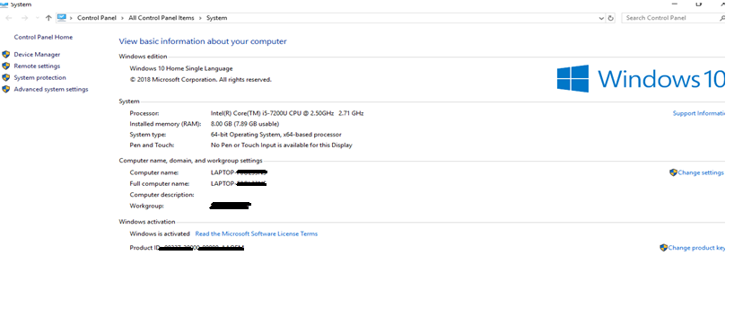
Environment Setup
Step 1 - Setup Java Development Kit (JDK)
You can download the latest version of java from below link.
https://www.oracle.com/technetwork/java/javase/downloads/index.htm
Step 2- Right Click on My Computer => Properties=>Click on Advanced system Settings

Slide 11
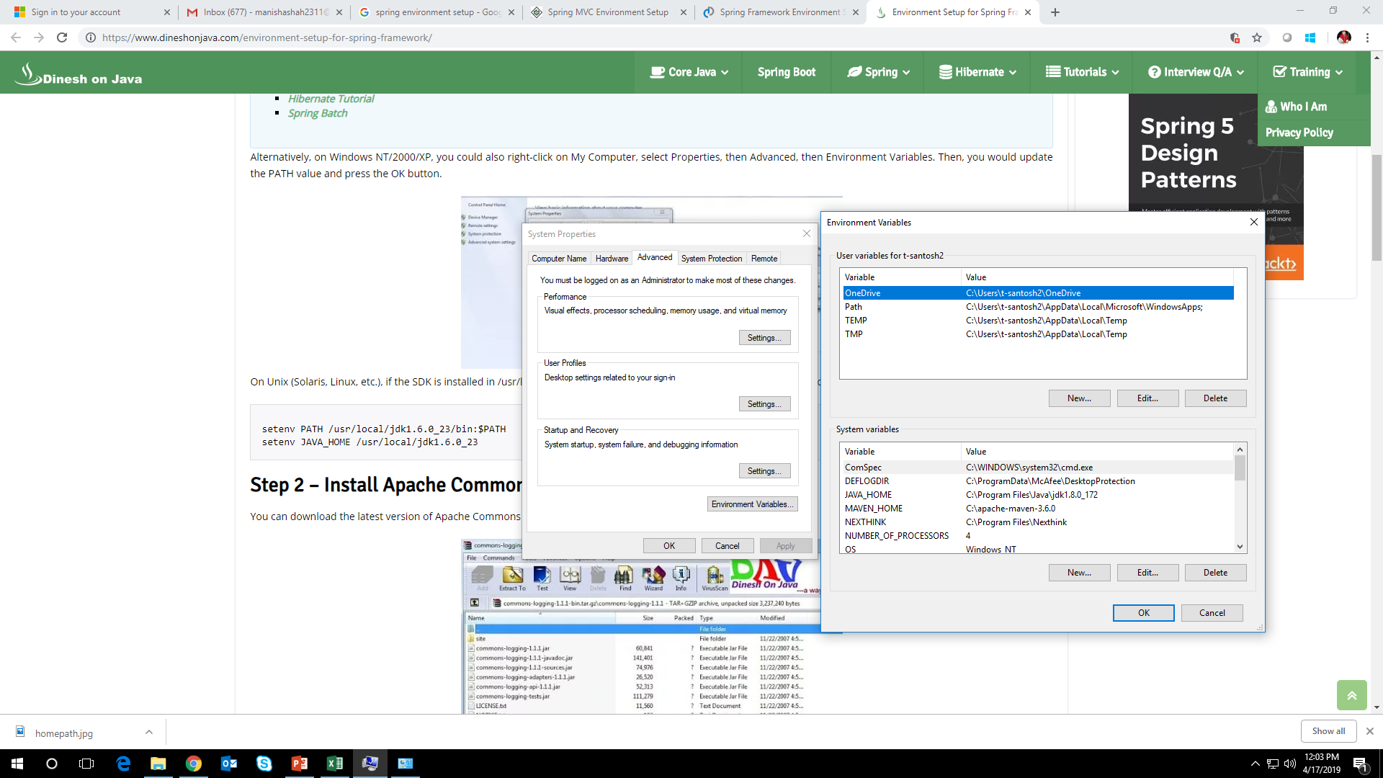
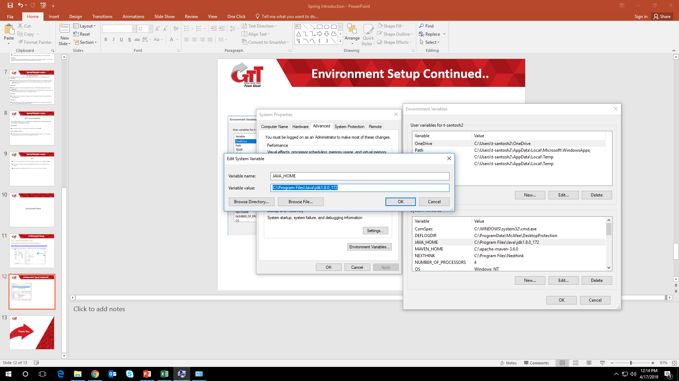
Environment Setup Cont..
Step 3- Environment variables=>System Variables=> Variable name as =>JAVA_HOME=>and value as =>your jdk folder location path. Click on OK.

Slide 12
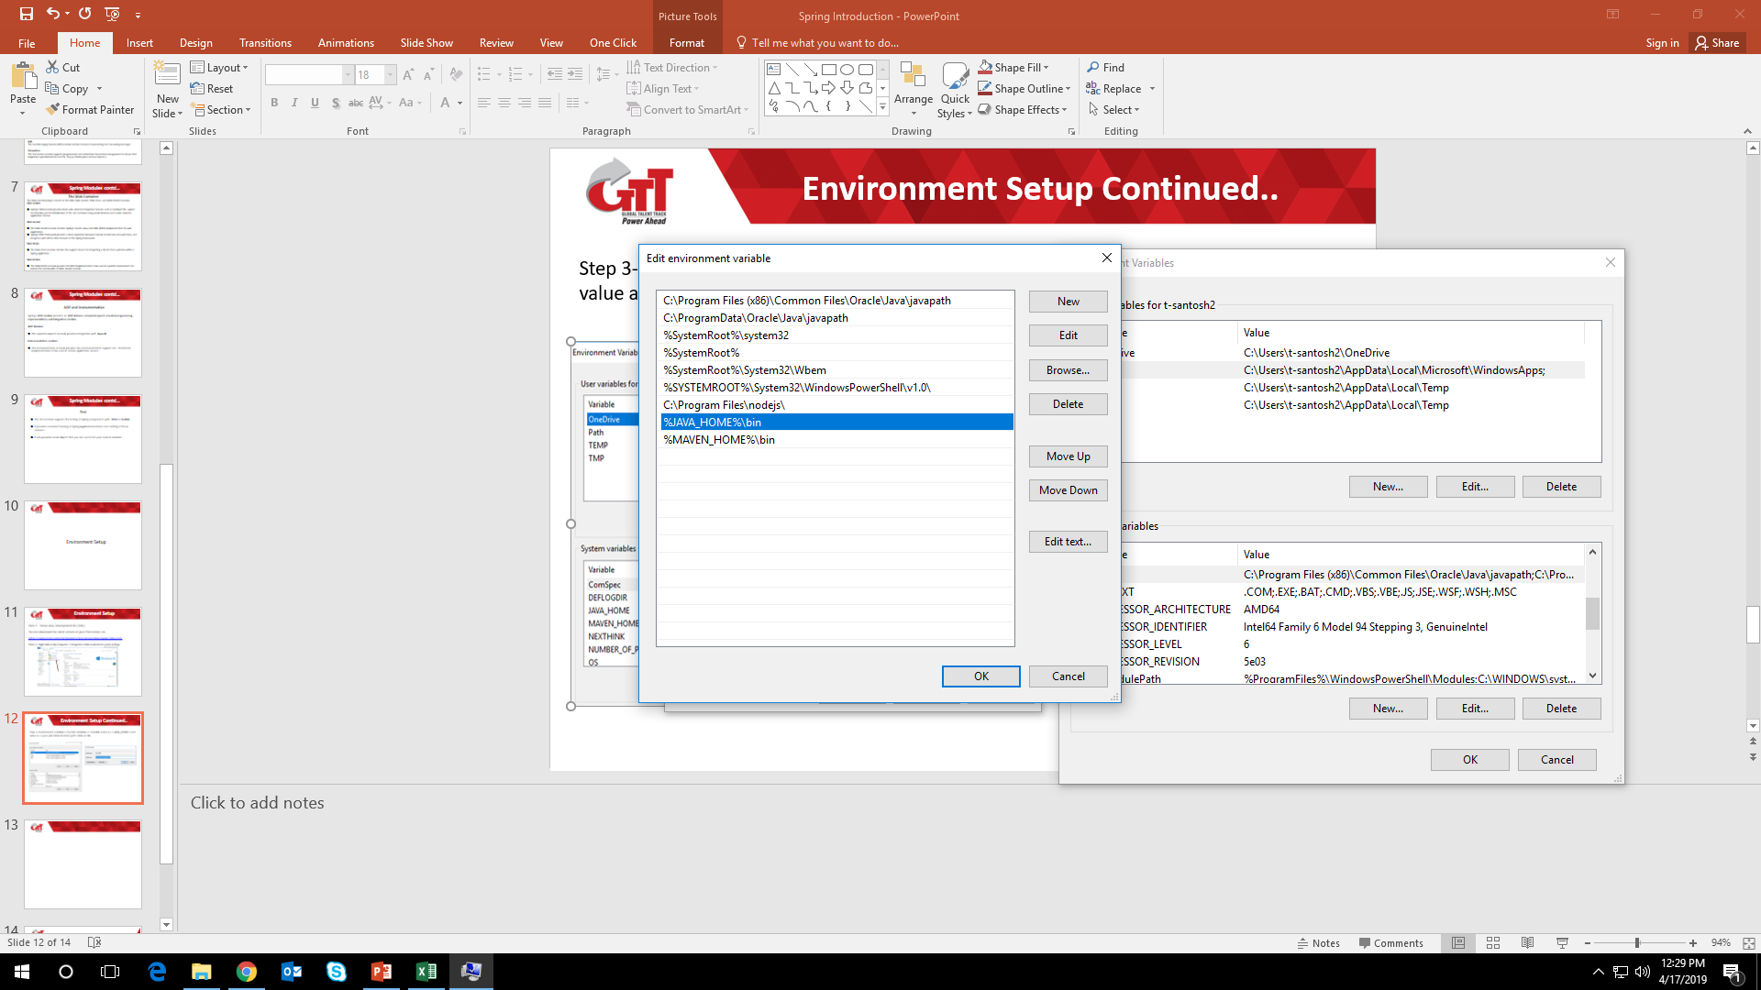
Environment Setup Continued..
Step 4: Edit Path variable and add the value to Path variable %JAVA_HOME%\bin and click on OK.

Slide 13
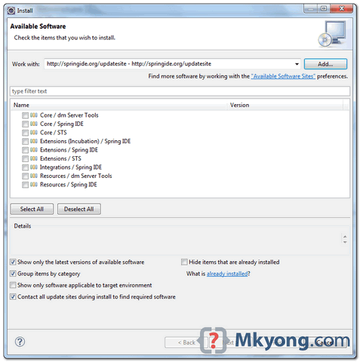
Environment Setup Continued..
Spring Environment setup for Eclipse
Step 1:
Eclipse IDE, click “Help” -> “Install New Software…”. Type “http://springide.org/updatesite” to access the Spring IDE update site. Select required Spring IDE features to be installed.
Take long time to install and restart Eclipse after finished.

Slide 14
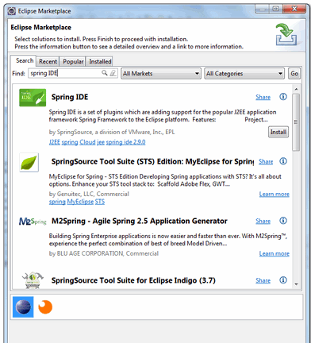
Environment Setup Continued..
Step 2.: Eclipse Marketplace
This is the prefer way, because you no need to remember the long Spring ide update URL. In Eclipse IDE, click on “Help” and then “Eclipse Marketplace“, type “Spring IDE“, follow the wizard to finish the installation.
Take long time to install and restart Eclipse after finished.

Slide 15
Hello World Example
To run Simple Hello World example we need to download the below Spring framework library.
Download the latest version of Spring framework binaries from https://repo.spring.io/release/org/springframework/spring.
For this example we have used spring-framework-4.1.6.RELEASE-dist.zip was downloaded on Windows machine. After the downloaded file was unzipped, it gives the following directory structure inside E:\spring.

Slide 16
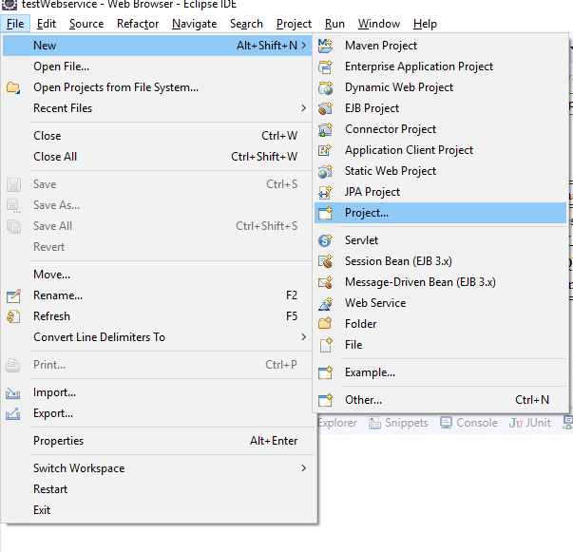
Demo: Hello World Example
Duration: 10 min
Step 1 - Create Java Project
The first step is to create a simple Java Project using Eclipse IDE. Follow the option File → New → Project and select Java Project wizard from the list. Now follow the wizard and name your project as HelloSpring.

Slide 17
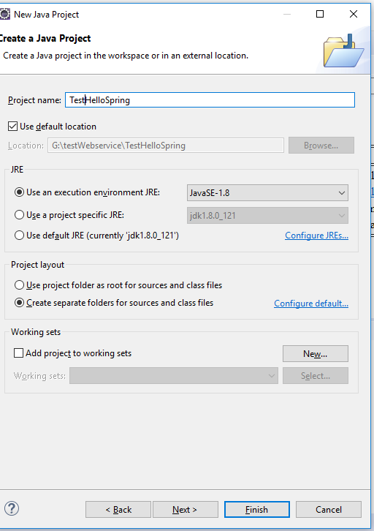
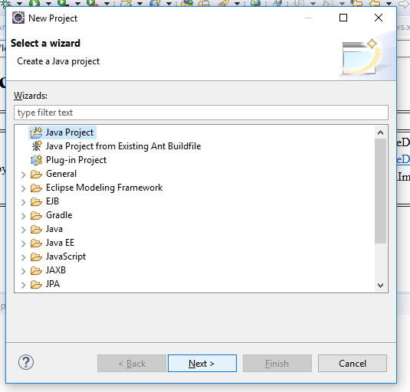
Demo: Hello World Example Cont..

Slide 18
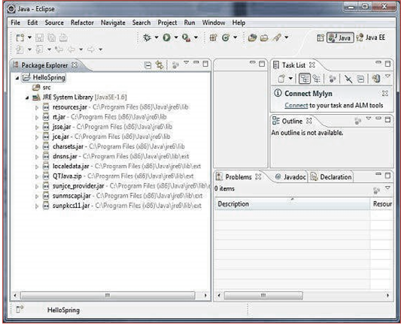
Demo: Hello World Example Cont..
Once your project is created successfully, you will have the following content in your Project Explorer −

Slide 19
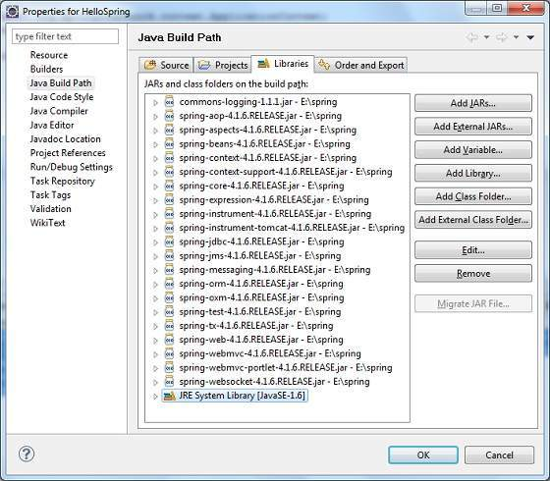
Demo: Hello World Example Cont..
Step 2 - Add Required Libraries
As a second step let us add Spring Framework and common logging API libraries in our project by right-click on project and in context menu − Build Path → Configure Build Path to display the Java Build Path window as follows −

Slide 20
Demo: Hello World Example Cont..
Add the following core JARs from Spring Framework and Common Logging installation directories
For this use Add External JARs
commons-logging-1.1.1
spring-aop-4.1.6.RELEASE
spring-aspects-4.1.6.RELEASE
spring-beans-4.1.6.RELEASE
spring-context-4.1.6.RELEASE
spring-context-support-4.1.6.RELEASE
spring-core-4.1.6.RELEASE
spring-expression-4.1.6.RELEASE
spring-instrument-4.1.6.RELEASE
spring-instrument-tomcat-4.1.6.RELEASE
spring-jdbc-4.1.6.RELEASE
spring-jms-4.1.6.RELEASE
spring-messaging-4.1.6.RELEASE
spring-orm-4.1.6.RELEASE
spring-oxm-4.1.6.RELEASE
spring-test-4.1.6.RELEASE
spring-tx-4.1.6.RELEASE
spring-web-4.1.6.RELEASE
spring-webmvc-4.1.6.RELEASE
spring-webmvc-portlet-4.1.6.RELEASE
spring-websocket-4.1.6.RELEASE

Slide 21
Demo: Hello World Example Cont..
Step 3 - Create Source Files
create actual source files under the HelloSpring project. First we need to create a package called com.test.hello. To do this, right click on src in package explorer section and follow the option − New → Package.
Next we will create HelloWorld.java and MainApp.java files under the com com.test.hello package.
Here is the content of HelloWorld.java file −
package com.test.hello;
public class HelloWorld {
private String message;
public void setMessage(String message){
this.message = message;
}
public void getMessage(){
System.out.println("Your Message : " + message);
}
}

Slide 22
Demo: Hello World Example Cont..
Following is the content of the second file MainApp.java −
package com.test.hello;
import org.springframework.context.ApplicationContext;
import org.springframework.context.support.ClassPathXmlApplicationContext;
public class MainApp {
public static void main(String[] args) {
ApplicationContext context = new ClassPathXmlApplicationContext("Beans.xml");
HelloWorld obj = (HelloWorld) context.getBean("helloWorld");
obj.getMessage();
}
}

Slide 23
Demo: Hello World Example Cont..
The first line in java file is to create application context where we used framework API ClassPathXmlApplicationContext(). It loads beans configuration file and takes care of creating and initializing all the objects, i.e. beans mentioned in the configuration file.
The second line is used to get the required bean using getBean()method of the created context. A bean ID is used to return a generic object, which can be casted to the actual object. Once you have an object, you can use this object to call any class method.
Step 4 - Create Bean Configuration File
You need to create a Bean Configuration file which is an XML file that sticks the beans, i.e. the classes together. This file needs to be created under the src directory as shown in the Image−
Notes:
Using Beans.xml we can assign assign unique IDs to various beans and to control the creation of objects with different values without impacting any of the Spring source files. For instance, using this file you can pass any value for "message" variable, print various values of message without impacting HelloWorld.java and MainApp.java files. Let us see how it works −

Slide 24
Demo: Hello World Example Cont..
<?xml version = "1.0" encoding = "UTF-8"?>
<beans xmlns = "http://www.springframework.org/schema/beans"
xmlns:xsi = "http://www.w3.org/2001/XMLSchema-instance"
xsi:schemaLocation = "http://www.springframework.org/schema/beans
http://www.springframework.org/schema/beans/spring-beans-3.0.xsd">
<bean id = "helloWorld" class = " com.test.hello.HelloWorld">
<property name = "message" value = "Hello World!"/>
</bean>
</beans>
Notes:
When Spring application gets loaded into the memory, Framework makes use of the above configuration file to create all the beans defined and assigns them a unique ID as defined in <bean> tag. You can use <property> tag to pass the values of different variables used at the time of object creation.

Slide 25
Demo: Hello World Example Cont..
Step 5 - Running the Program
Now Right click on Project and Run the application as Java Application.
Will see the following output on the console.
Jun 13, 2019 3:04:12 PM org.springframework.context.support.ClassPathXmlApplicationContext prepareRefresh
INFO: Refreshing org.springframework.context.support.ClassPathXmlApplicationContext@300ffa5d: startup date [Thu Jun 13 15:04:12 IST 2019]; root of context hierarchy
Jun 13, 2019 3:04:12 PM org.springframework.beans.factory.xml.XmlBeanDefinitionReader loadBeanDefinitions
INFO Loading XML bean definitions from class path resource [Beans.xml]
Your Message : Hello World!

Slide 26
Summary
In this Module, we have learnt the following:
Architecture of Spring Core.
Environment Setup
Hello World Example

Slide 27

Thank You

